Slide 1
WebDev Final Overview
What is it and what will it contain?

Slide 2
Front Page
Top will be bootstrap navbar
Will include a couple links to “Game Reviews” And “Game Stores”
The middle of the page will include a picture along with a button navigating user to specific page – “FPS”, “RPG”, and so on.

Slide 3
RPG, FPS,… Pages
Each page will include a handful of pictures and a brief description of what the said genre entails.

Slide 4
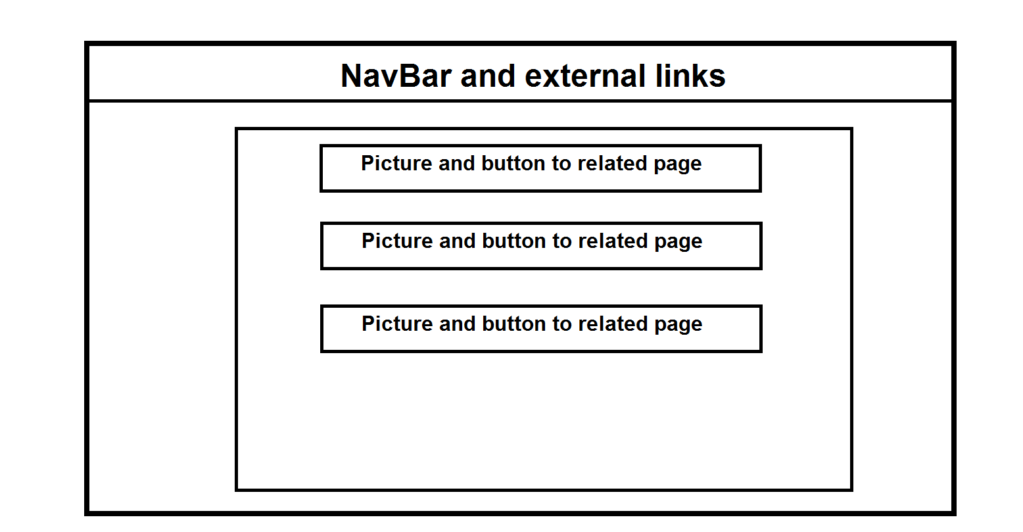
Main Page rough design

Slide 5
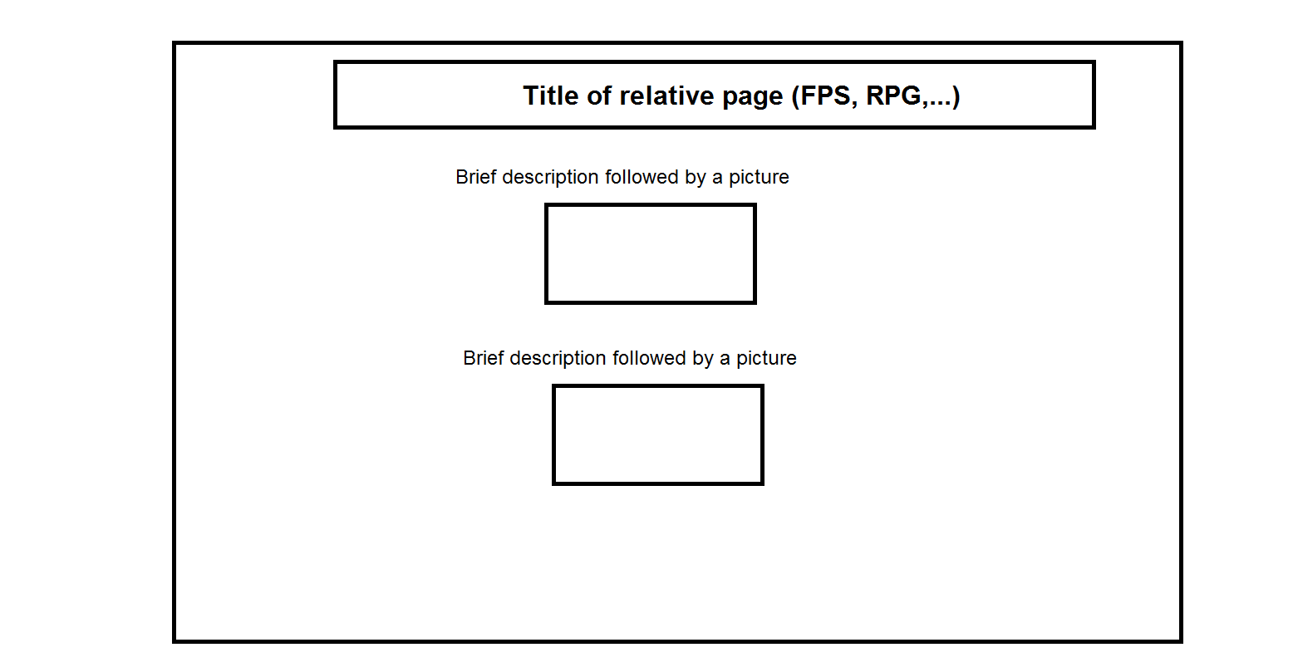
Backpage rough design

